Slide 1
Walmart sales forecasting Retail analysis with walmart data
Suruchi Kumar– 18070122072
Vattikuti Sree Sahithi-18070122077
Yashika Chhabaria-18070122079
Arundarasi Rajendran-18070122081

Slide 2
Introduction

Slide 3
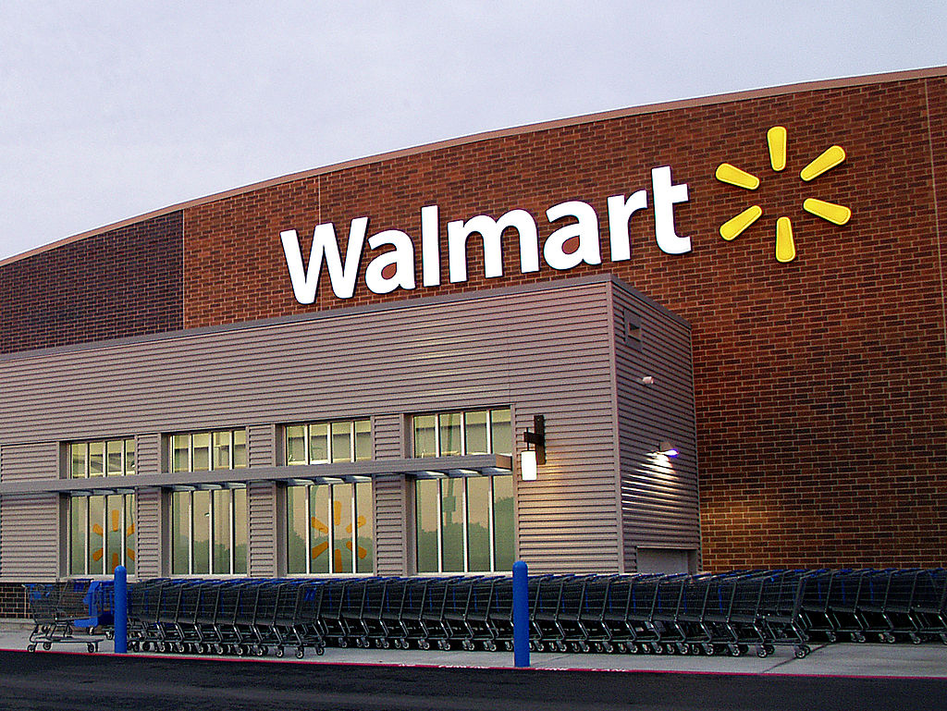
Walmart -
Walmart is an American multinational retail corporation that operates a chain of hypermarkets, discount department stores, and grocery stores from the United States, headquartered in Bentonville.
The company was founded by Sam Walton in 1962.
As of January 31, 2021, Walmart has 11,443 stores and clubs in 26 countries, operating under 54 different names.
Predicting future sales for a company is one of the most important aspects of strategic planning.
Walmart is the best example to work with as a beginner as it has the most retail data set.
Also, Walmart used this sales prediction problem for recruitment purposes too.
One of the leading retail stores in the US, there are certain events and holidays which impact sales on each day.
There are sales data available for 45 stores of Walmart.
An ideal ML algorithm will predict demand accurately, find the economic conditions including CPI, Unemployment Index, etc.

Slide 4
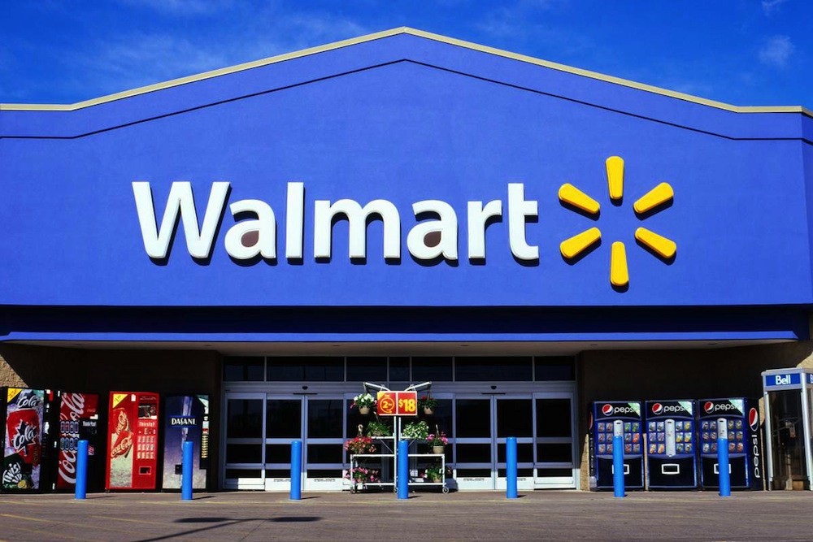

Walmart sales forecasting-
The data collected ranges from 2010 to 2012, having 45 Walmart stores across the country in the analysis.
Each store contains several departments, we are predicting the department-wide sales for each store.
We have external data available like CPI, Unemployment Rate and Fuel Prices in the region of each store.
Walmart runs several promotional markdown events throughout the year.
These markdowns include prominent holidays, like the Super Bowl, Labour Day, Thanksgiving, and Christmas.
The weeks including holidays are five times higher in the evaluation than non-holiday weeks.

Slide 5
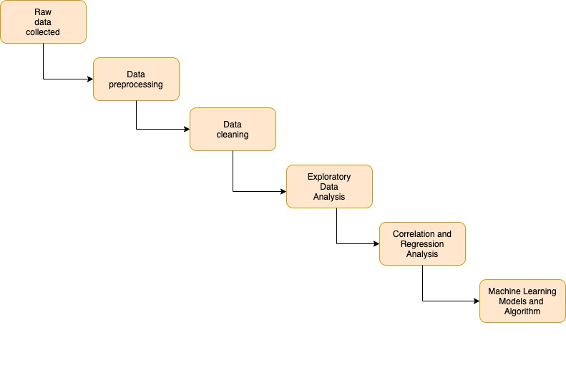
Flow chart diagram(Design architecture)-

Slide 6
Tools used-
The tools used for this project are:-
Anaconda prompt server
Jupyter notebook
Microsoft Word document
Microsoft Powerpoint presentation

Slide 7
Application

Slide 8
Data set of the project-
The dataset for this project was taken from :
https://www.kaggle.com/vik2012kvs/walmart-dataretail-analysis
There are sales data taken from 45 stores of Walmart. This is the data that covers sales from 05-02-2010 to 01-11-2012.
The data contains:
Store - the store number
Date - the week of sales
Weekly_Sales - sales for the given store
Holiday_Flag - whether the week is a special holiday week
Temperature - Temperature on the day of sale
Fuel_Price - Cost of fuel in the region
CPI – Prevailing consumer price index
Unemployment - Prevailing unemployment rate

Slide 9

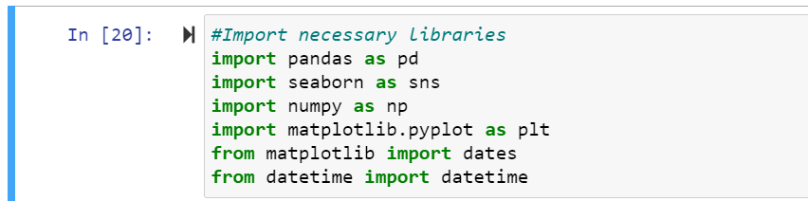
Importing libraries-

Slide 10
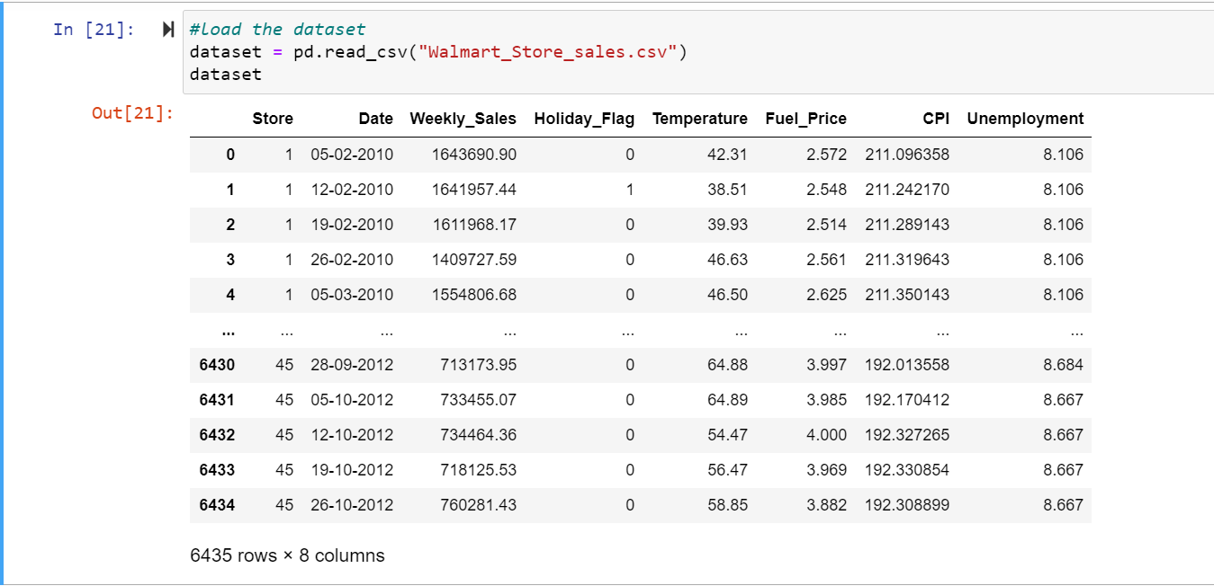
Data collection: Reading the csv file-

Slide 11

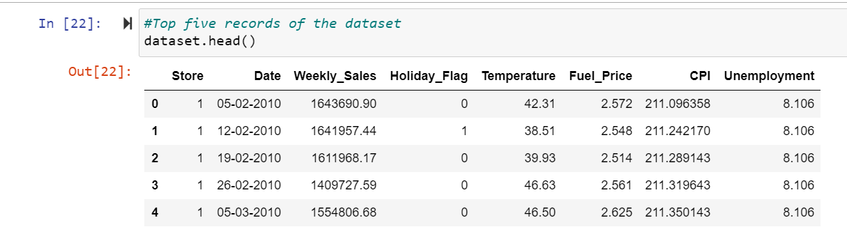
First 5 displays of the data set-

Slide 12
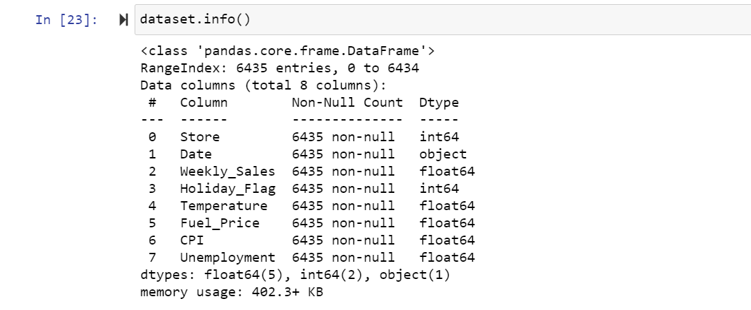
Data set information-

Slide 13
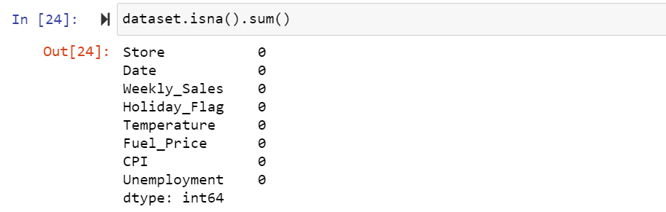
Data pre-processing-

Slide 14
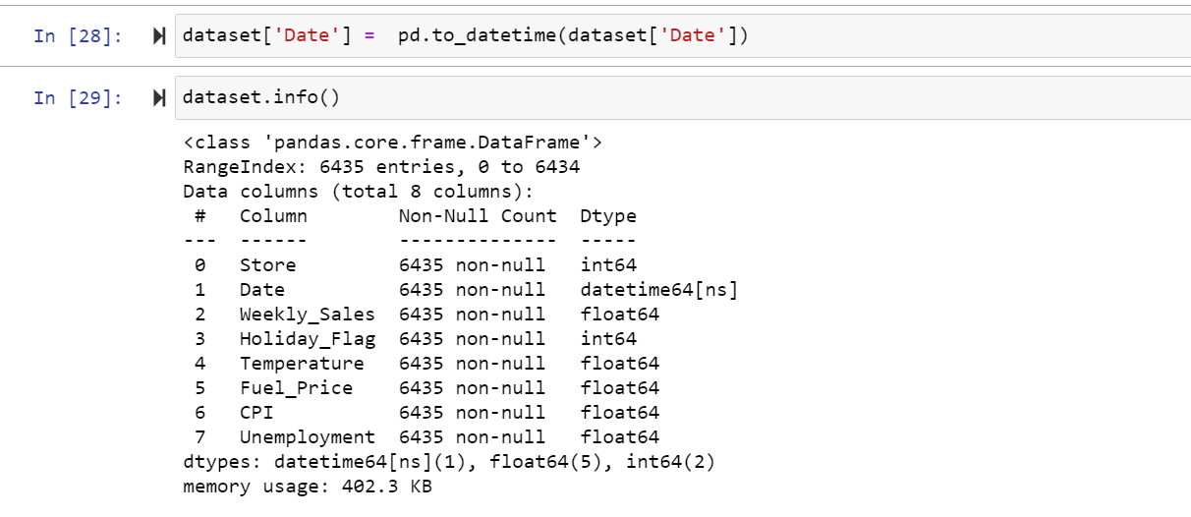

Slide 15
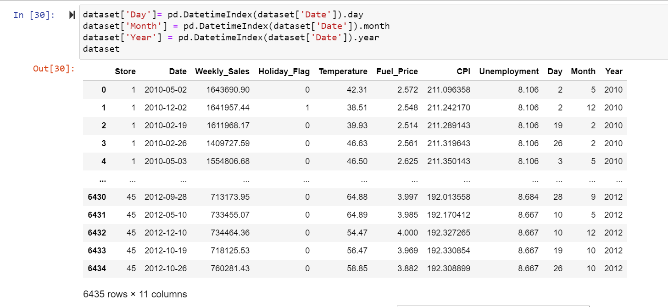

Slide 16
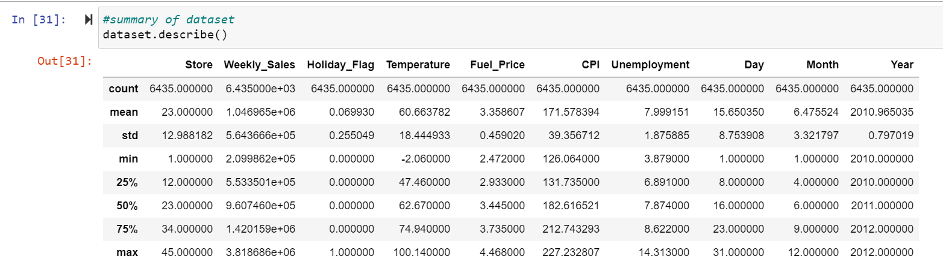

Slide 17
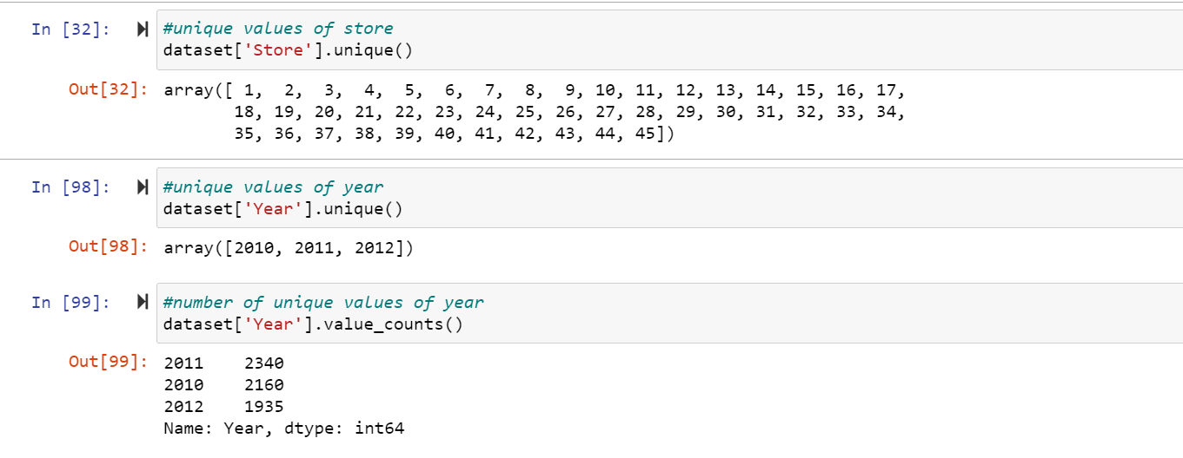

Slide 18
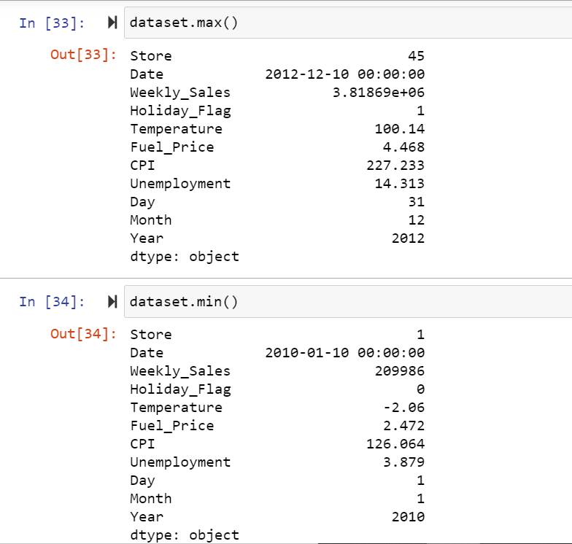

Slide 19
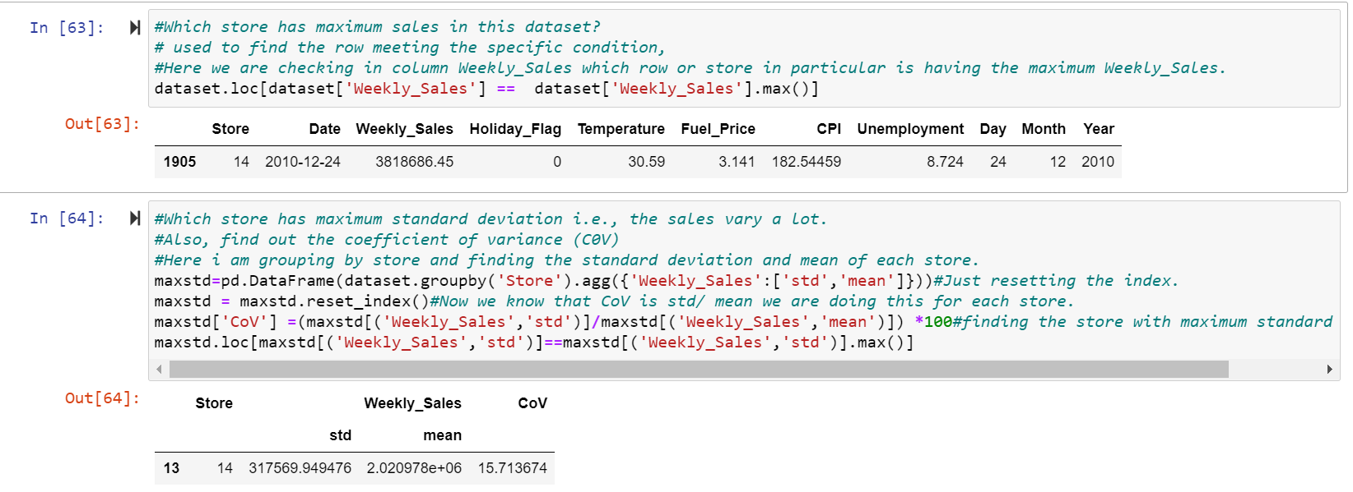

Slide 20
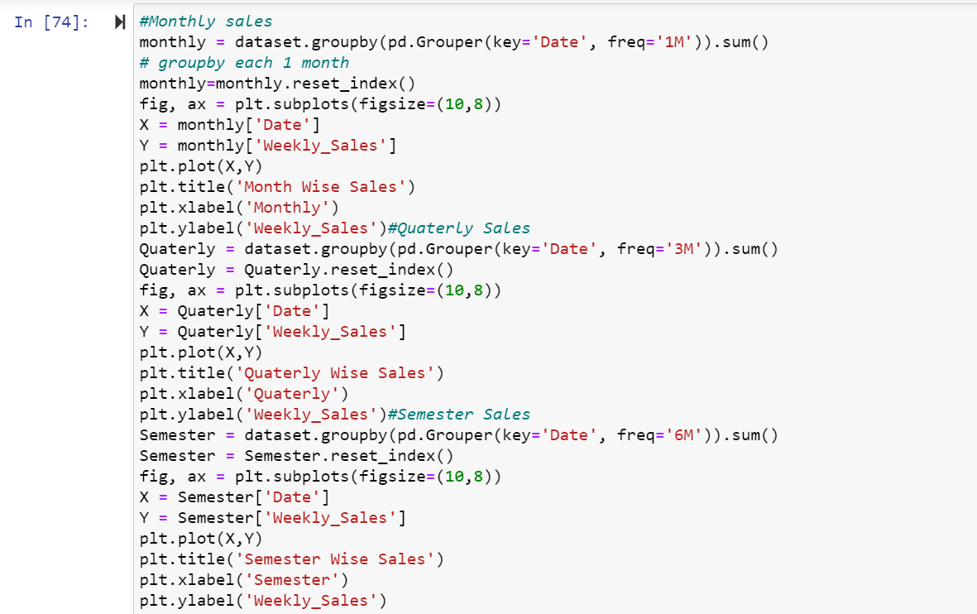
Statistics-

Slide 21
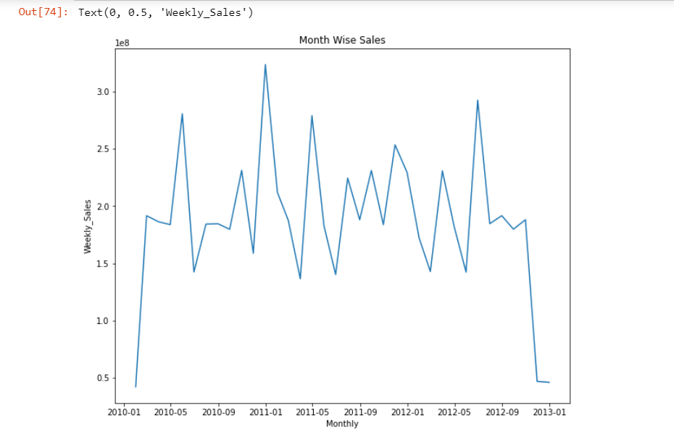
Statistics-

Slide 22
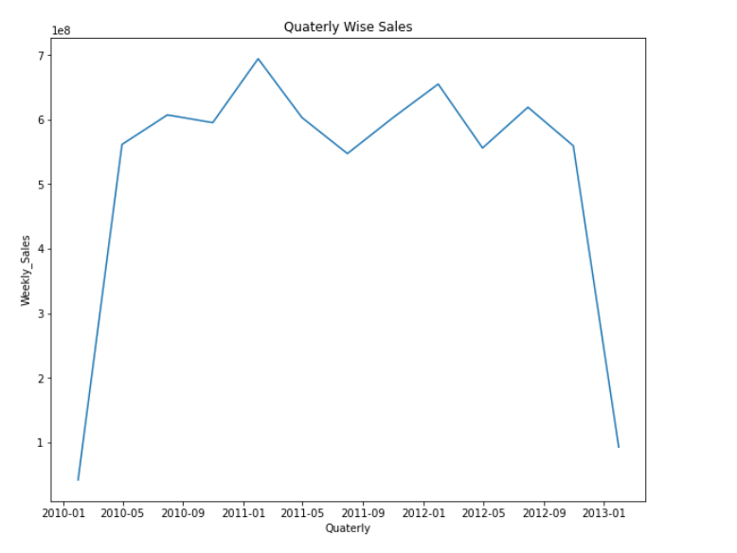
Statistics-

Slide 23
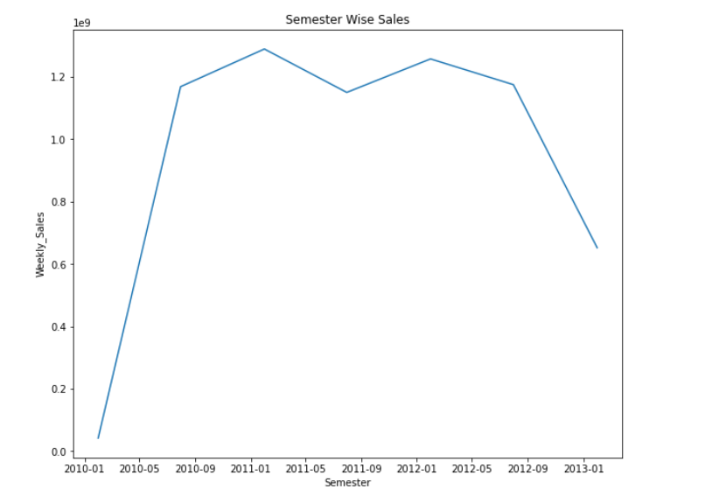
Statistics-

Slide 24
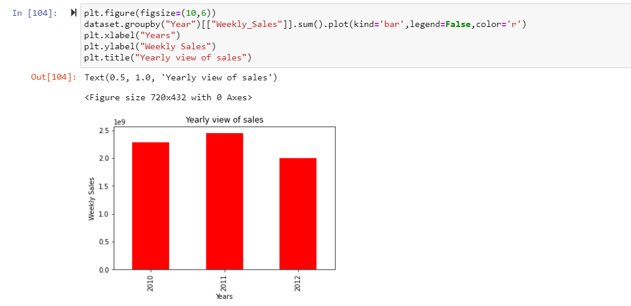
Statistics-

Slide 25
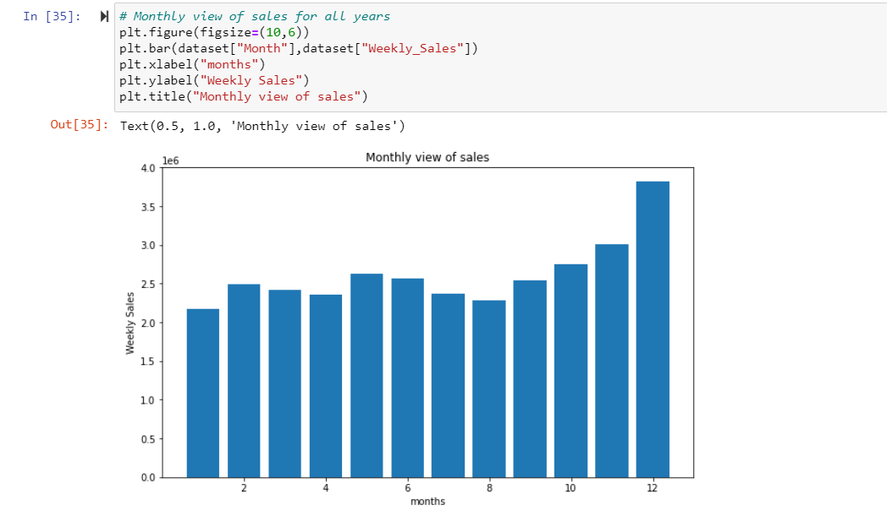
Statistics-

Slide 26
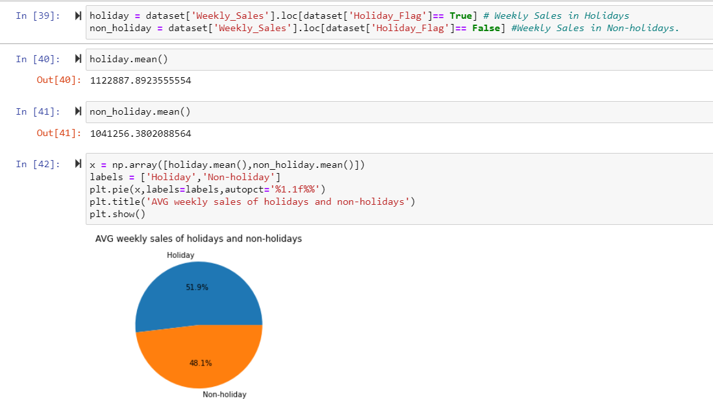
Statistics-

Slide 27
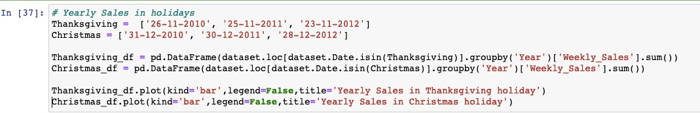
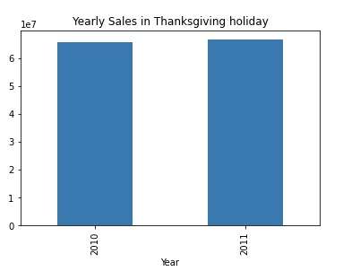
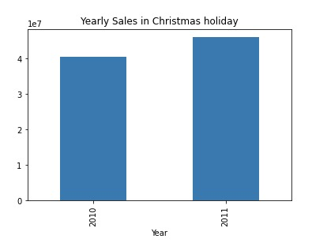
Statistics-

Slide 28
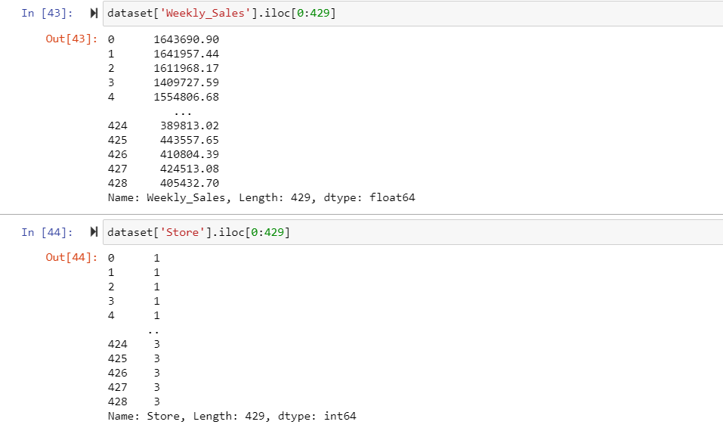
Statistics-

Slide 29
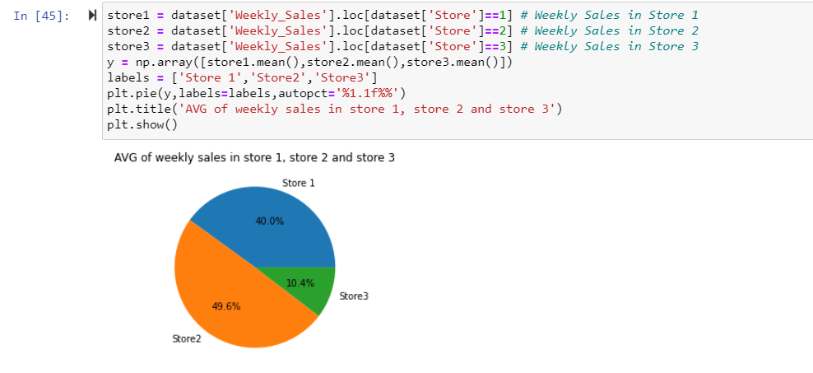
Statistics-

Slide 30
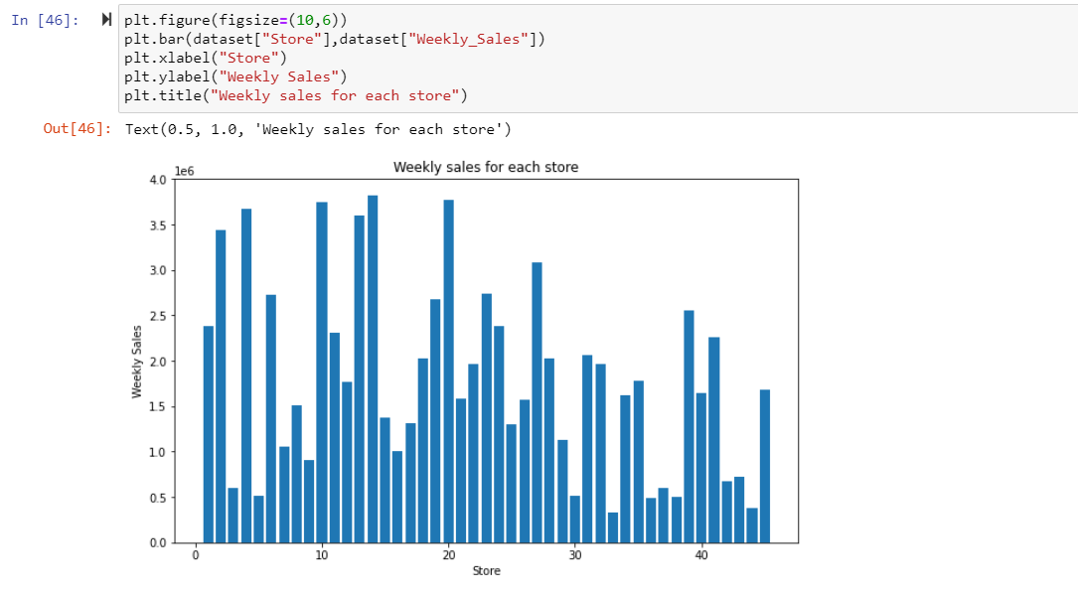
Statistics-

Slide 31
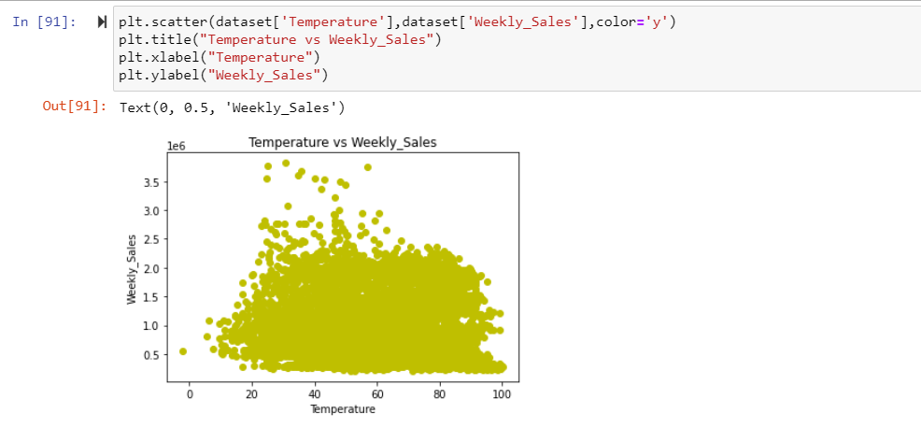
Statistics-

Slide 32
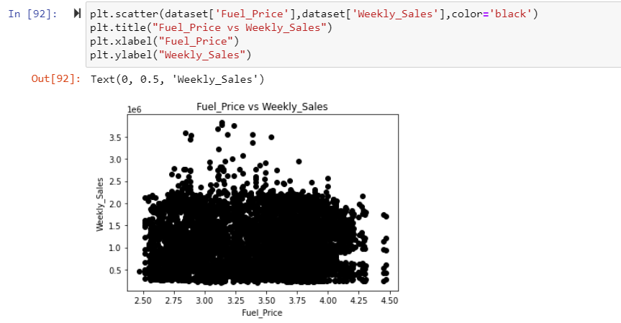
Statistics-

Slide 33
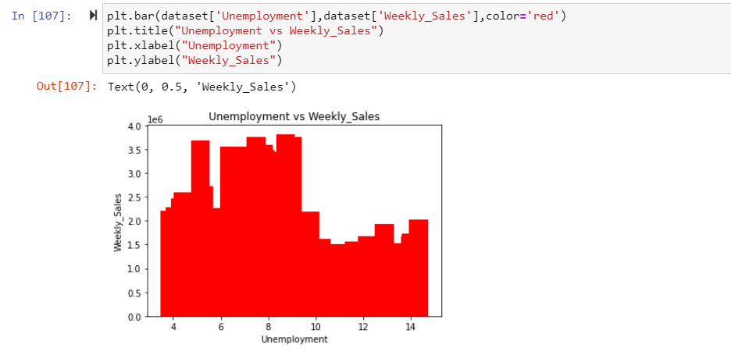
Statistics-

Slide 34
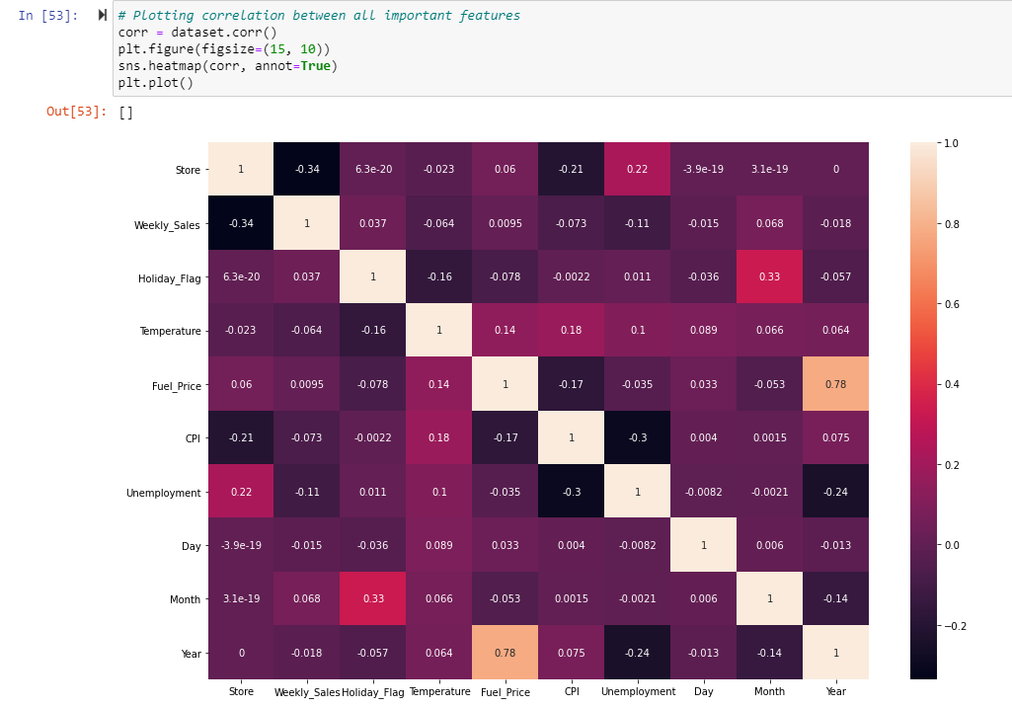
Correlation-

Slide 35
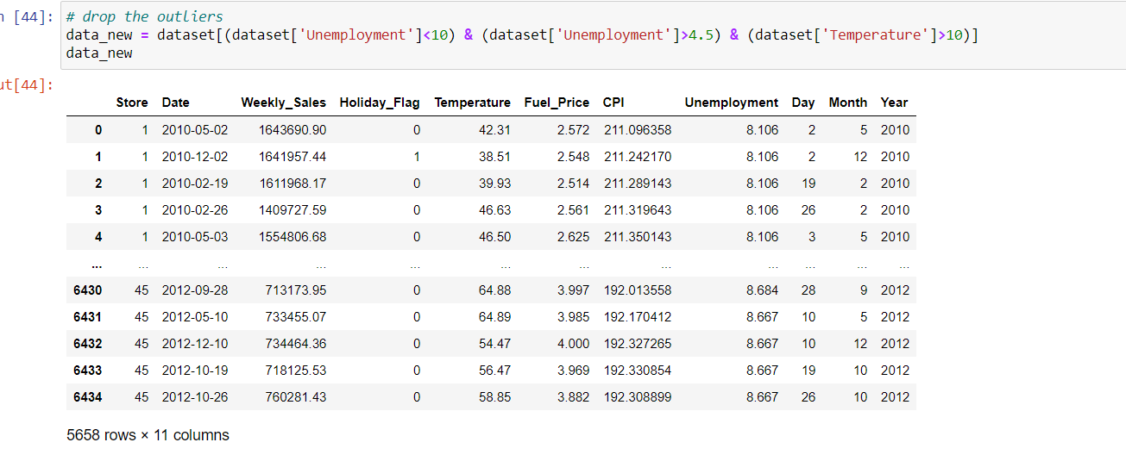
Outliers-

Slide 36
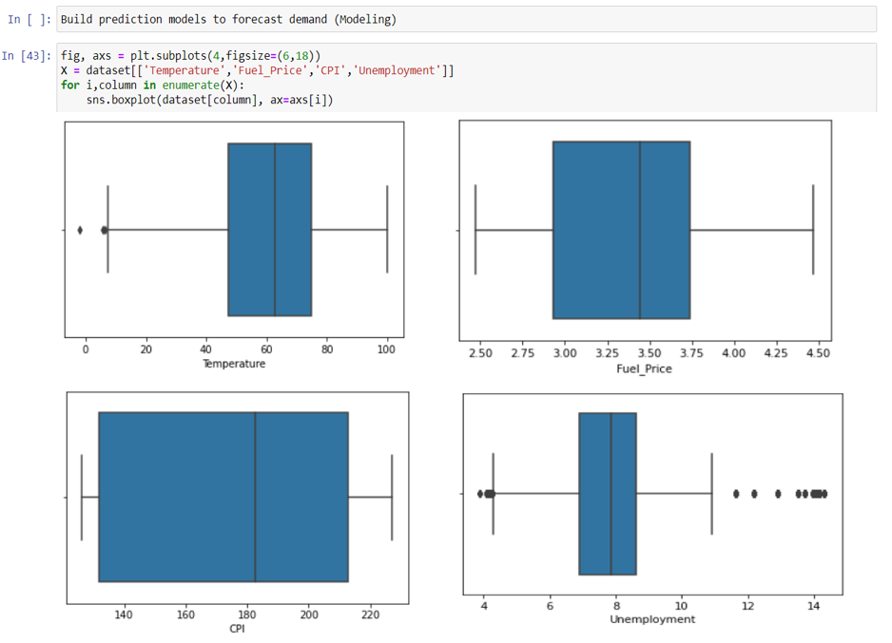

Slide 37
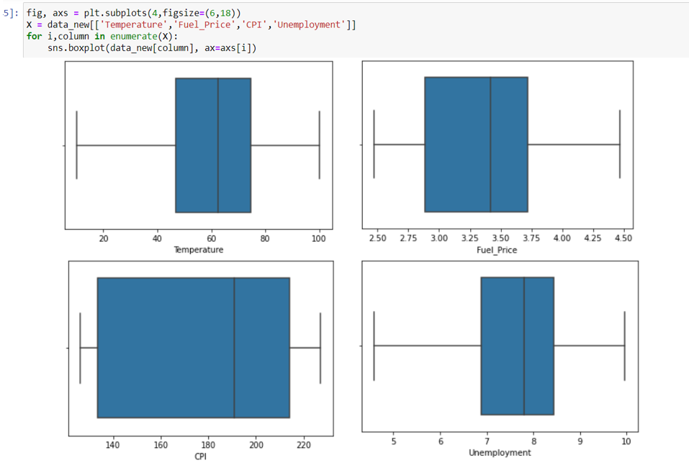

Slide 38
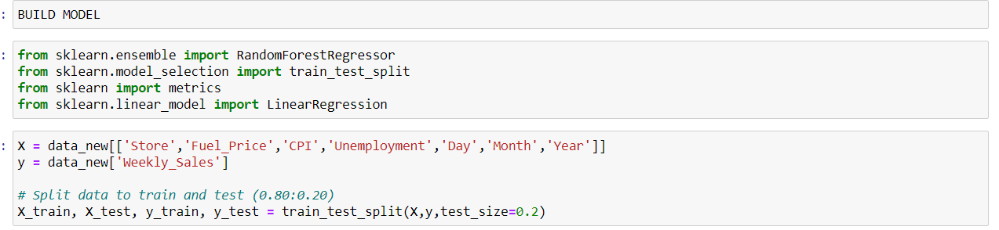
Building Machine Learning model-

Slide 39
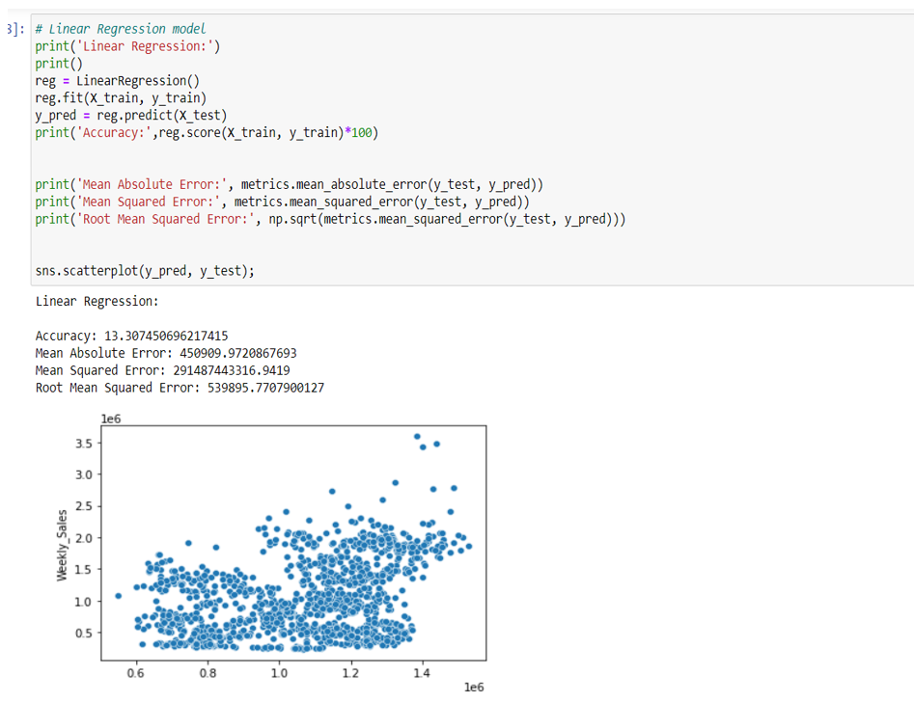
Linear Regression Model-

Slide 40
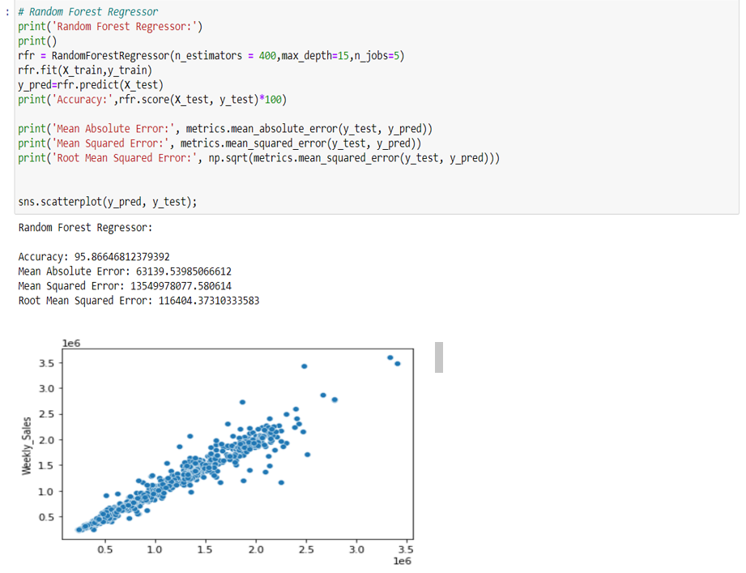
Random Forest Regressor-

Slide 41
Comparative analysis-
Random Forest Regressor
Linear regression
Accuracy- 95.87
Mean Absolute error- 63139.54
Mean Squared error- 13549978077.580614
Root Mean Squared Error- 116404.373
Accuracy- 13.31
Mean Absolute error- 450909.97
Mean Squared error- 291487443316.9419
Root Mean Squared Error- 539895.770

Slide 42

Conclusion

Slide 43
Thank You!
Suruchi Kumar– 18070122072
Vattikuti Sree Sahithi-18070122077
Yashika Chhabaria-18070122079
Arundarasi Rajendran-18070122081

